Slide 1
Introduction to Quantum simulation
林亮昕

Slide 2

Goal?
Simulating the time evolution with given Hamiltonian
$$\left.|ψ(t)\right\rangle =exp⁡(−i\hat{H}t)\left.|ψ(0)\right\rangle$$

Slide 3

Can classical computer make it?
Feynman--Hardly possible.

Slide 4
Fail of classical quantum computer
1.Cost exponential memory: need 2*(2^n) memory.
(Each state has real and imagine part)
(Quantum computer :n qubit)
2.Cost exponential Calculation
3. Numerical sign problem

Slide 5
Process of Quantum simulation
Initialization
Hamiltonian Evolution
Data Extraction
All need to complete in Polynomial Time!

Slide 6

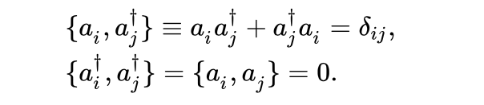
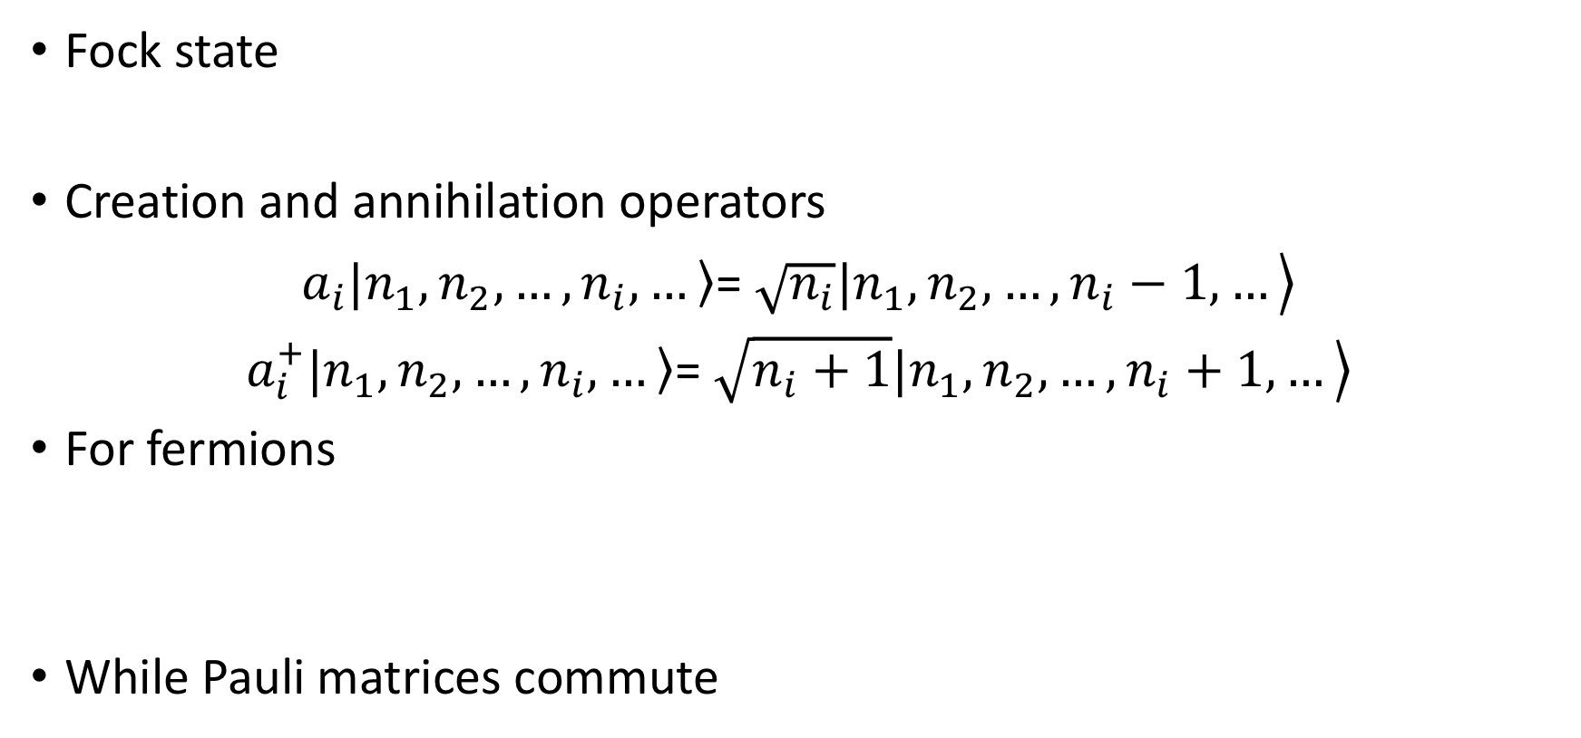
Review of Second Quantization
Fock state
Creation and annihilation operators
$a_{i}\left.|n_{1},n_{2},…,n_{i},…\right\rangle$= $\left.\sqrt{n_{i}}|n_{1},n_{2},…,n_{i}−1,…\right\rangle$
$a_{i}^{+}\left.|n_{1},n_{2},…,n_{i},…\right\rangle$= $\left.\sqrt{n_{i}+1}|n_{1},n_{2},…,n_{i}+1,…\right\rangle$
For fermions
While Pauli matrices commute

Slide 7
Initialization
Direct preparation ( e.g. 00000…0 state)
Fermions: Linear combination of slater determinant

Slide 8
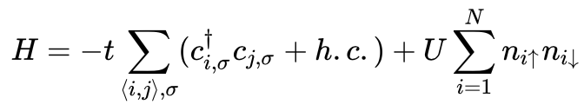
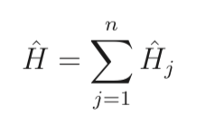
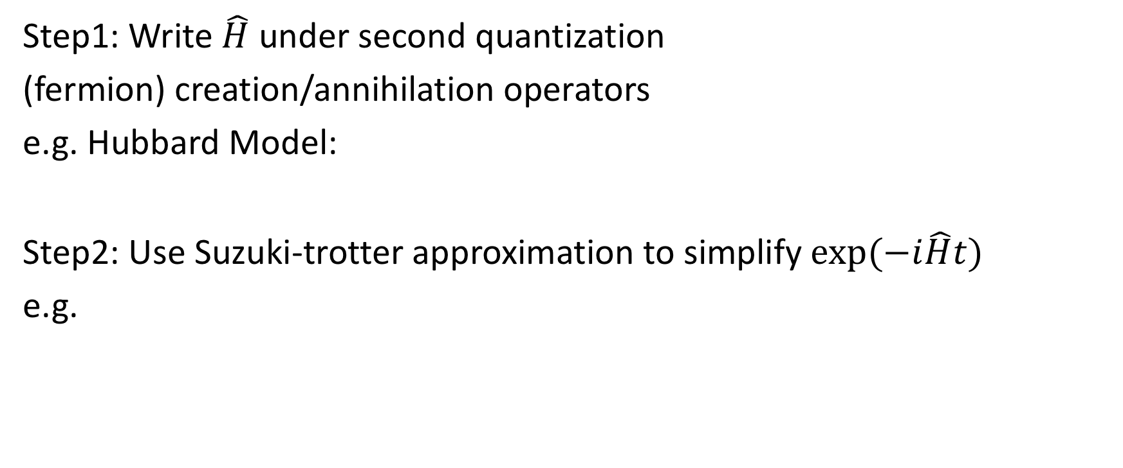
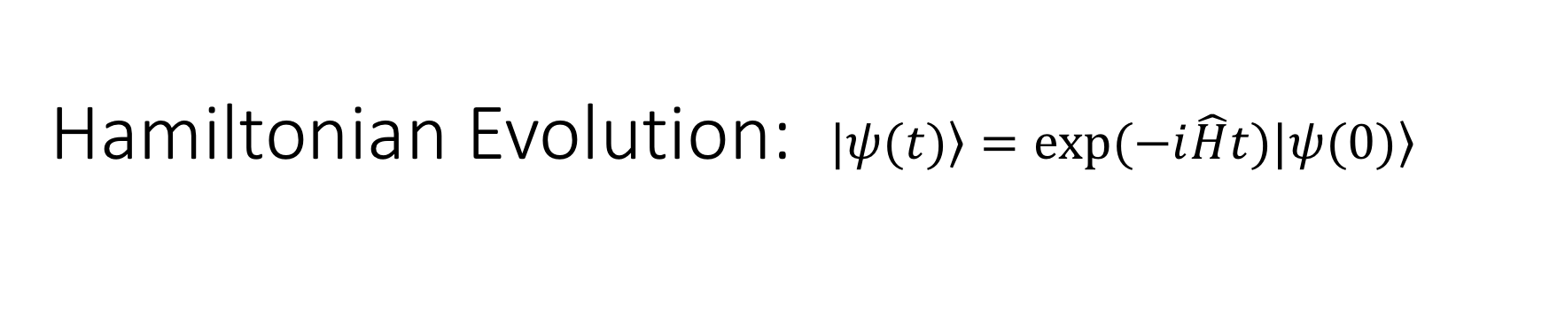
Hamiltonian Evolution: $\left.|ψ(t)\right\rangle =exp⁡(−i\hat{H}t)\left.|ψ(0)\right\rangle$
Step1: Write $\hat{H}$ under second quantization
(fermion) creation/annihilation operators
e.g. Hubbard Model:
Step2: Use Suzuki-trotter approximation to simplify $exp⁡(−i\hat{H}t)$
e.g.

Slide 9
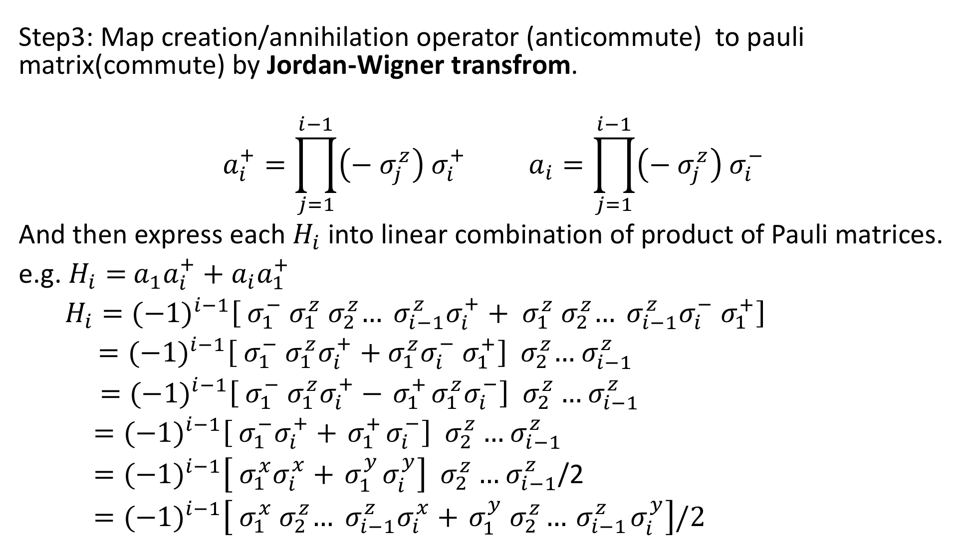
Step3: Map creation/annihilation operator (anticommute) to pauli matrix(commute) by Jordan-Wigner transfrom.
$$a_{i}^{+}=\prod_{j=1}^{i−1}{\left(−{ σ}_{j}^{z}\right){ σ}_{i}^{+}} a_{i}=\prod_{j=1}^{i−1}{\left(−{ σ}_{j}^{z}\right){ σ}_{i}^{−}}$$
And then express each $H_{i}$ into linear combination of product of Pauli matrices.
e.g. $H_{i}=$ ${a_{1}a}_{i}^{+}+{a_{i}a}_{1}^{+}$
$H_{i}={(−1)}^{i−1}\left[{{ σ}_{1}^{−}{ σ}_{1}^{z}{ σ}_{2}^{z}…{ σ}_{i−1}^{z}σ}_{i}^{+}+{{ σ}_{1}^{z}{ σ}_{2}^{z}…{ σ}_{i−1}^{z}σ}_{i}^{−}{ σ}_{1}^{+}\right]$
$={(−1)}^{i−1}\left[{{ σ}_{1}^{−}{ σ}_{1}^{z}σ}_{i}^{+}+{σ_{1}^{z}σ}_{i}^{−}{ σ}_{1}^{+}\right]$ ${ σ}_{2}^{z}…{ σ}_{i−1}^{z}$
$={(−1)}^{i−1}\left[{{ σ}_{1}^{−}{ σ}_{1}^{z}σ}_{i}^{+}−{ σ}_{1}^{+}{σ_{1}^{z}σ}_{i}^{−}\right] { σ}_{2}^{z}…{ σ}_{i−1}^{z}$
$={(−1)}^{i−1}\left[{{ σ}_{1}^{−}σ}_{i}^{+}+{ σ}_{1}^{+}σ_{i}^{−}\right] { σ}_{2}^{z}…{ σ}_{i−1}^{z}$
$={(−1)}^{i−1}\left[{{ σ}_{1}^{x}σ}_{i}^{x}+{ σ}_{1}^{y}σ_{i}^{y}\right] { σ}_{2}^{z}…{ σ}_{i−1}^{z}$/2
$={(−1)}^{i−1}\left[{{ σ}_{1}^{x}{ σ}_{2}^{z}…{ σ}_{i−1}^{z}σ}_{i}^{x}+{ σ}_{1}^{y}{ σ}_{2}^{z}…{ σ}_{i−1}^{z}σ_{i}^{y}\right]/2$

Slide 10
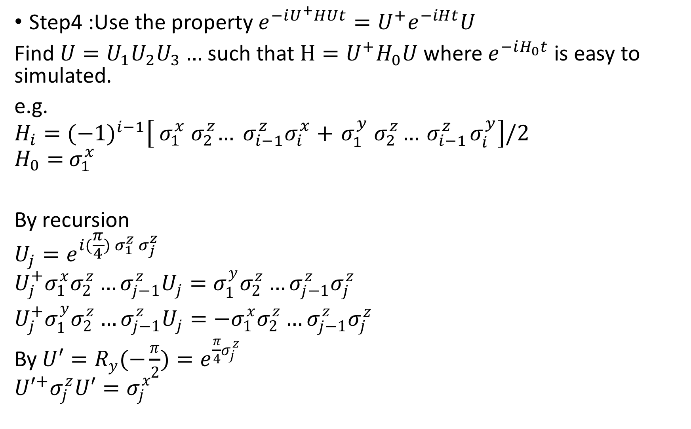
Step4 :Use the property ${{e^{−iU^{+}HUt}=U}^{+}e}^{−iHt}U$
Find ${U=U}_{1}U_{2}U_{3}…$ such that $H=U^{+}H_{0}U$ where $e^{−iH_{0}t}$is easy to simulated.
e.g.
$$H_{i}={(−1)}^{i−1}\left[{{ σ}_{1}^{x}{ σ}_{2}^{z}…{ σ}_{i−1}^{z}σ}_{i}^{x}+{ σ}_{1}^{y}{ σ}_{2}^{z}…{ σ}_{i−1}^{z}σ_{i}^{y}\right]/2$$
$$H_{0}={ σ}_{1}^{x}$$
By recursion
$$U_{j}=e^{i(\frac{π}{4}){ σ}_{1}^{z}{ σ}_{j}^{z}}$$
$$U_{j}^{+}σ_{1}^{x}σ_{2}^{z}…σ_{j−1}^{z}U_{j}=σ_{1}^{y}σ_{2}^{z}…σ_{j−1}^{z}σ_{j}^{z}$$
$U_{j}^{+}σ_{1}^{y}σ_{2}^{z}…σ_{j−1}^{z}U_{j}={−σ}_{1}^{x}σ_{2}^{z}…σ_{j−1}^{z}σ_{j}^{z}$
By ${U′=R}_{y}(−\frac{π}{2})=e^{\frac{π}{4}σ_{j}^{z}}$
$${U′}^{+}σ_{j}^{z}U′=σ_{j}^{x}$$

Slide 11
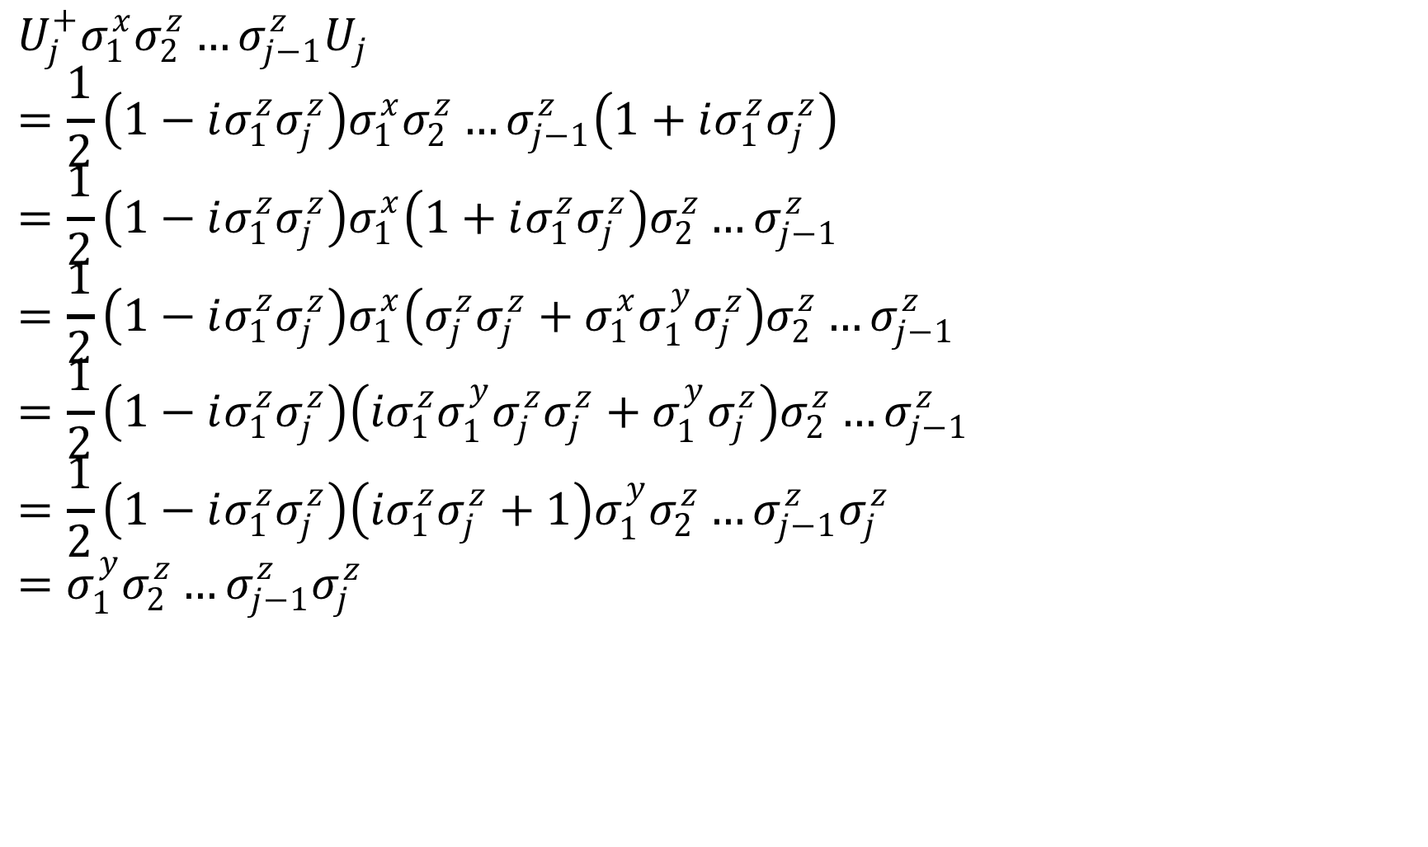
$$U_{j}^{+}σ_{1}^{x}σ_{2}^{z}…σ_{j−1}^{z}U_{j}$$
$$=\frac{1}{2}\left(1−iσ_{1}^{z}σ_{j}^{z}\right)σ_{1}^{x}σ_{2}^{z}…σ_{j−1}^{z}\left(1+iσ_{1}^{z}σ_{j}^{z}\right)$$
$$=\frac{1}{2}\left(1−iσ_{1}^{z}σ_{j}^{z}\right)σ_{1}^{x}\left(1+iσ_{1}^{z}σ_{j}^{z}\right)σ_{2}^{z}…σ_{j−1}^{z}$$
$$=\frac{1}{2}\left(1−iσ_{1}^{z}σ_{j}^{z}\right)σ_{1}^{x}\left(σ_{j}^{z}σ_{j}^{z}+σ_{1}^{x}σ_{1}^{y}σ_{j}^{z}\right)σ_{2}^{z}…σ_{j−1}^{z}$$
$$=\frac{1}{2}\left(1−iσ_{1}^{z}σ_{j}^{z}\right)\left({iσ}_{1}^{z}σ_{1}^{y}σ_{j}^{z}σ_{j}^{z}+σ_{1}^{y}σ_{j}^{z}\right)σ_{2}^{z}…σ_{j−1}^{z}$$
$$=\frac{1}{2}\left(1−iσ_{1}^{z}σ_{j}^{z}\right)\left({iσ}_{1}^{z}σ_{j}^{z}+1\right)σ_{1}^{y}σ_{2}^{z}…σ_{j−1}^{z}σ_{j}^{z}$$
$$=σ_{1}^{y}σ_{2}^{z}…σ_{j−1}^{z}σ_{j}^{z}$$

Slide 12
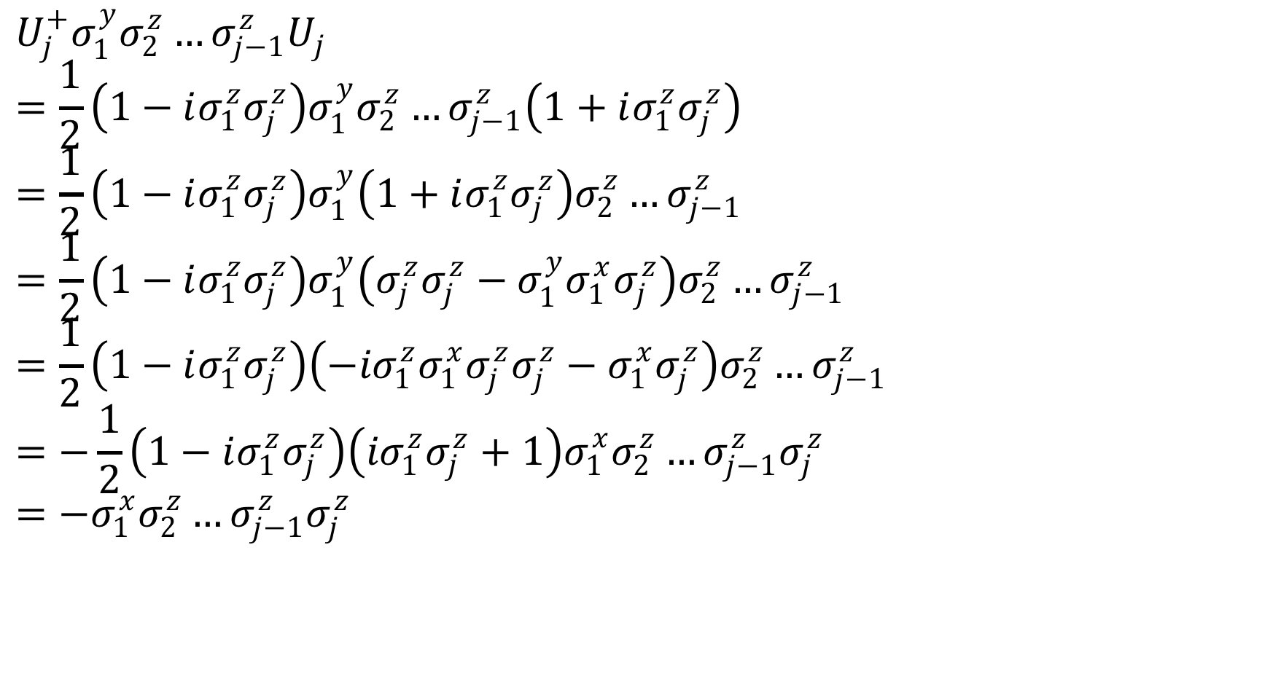
$$U_{j}^{+}σ_{1}^{y}σ_{2}^{z}…σ_{j−1}^{z}U_{j}$$
$$=\frac{1}{2}\left(1−iσ_{1}^{z}σ_{j}^{z}\right)σ_{1}^{y}σ_{2}^{z}…σ_{j−1}^{z}\left(1+iσ_{1}^{z}σ_{j}^{z}\right)$$
$$=\frac{1}{2}\left(1−iσ_{1}^{z}σ_{j}^{z}\right)σ_{1}^{y}\left(1+iσ_{1}^{z}σ_{j}^{z}\right)σ_{2}^{z}…σ_{j−1}^{z}$$
$$=\frac{1}{2}\left(1−iσ_{1}^{z}σ_{j}^{z}\right)σ_{1}^{y}\left(σ_{j}^{z}σ_{j}^{z}−σ_{1}^{y}σ_{1}^{x}σ_{j}^{z}\right)σ_{2}^{z}…σ_{j−1}^{z}$$
$$=\frac{1}{2}\left(1−iσ_{1}^{z}σ_{j}^{z}\right)\left({−iσ}_{1}^{z}σ_{1}^{x}σ_{j}^{z}σ_{j}^{z}−σ_{1}^{x}σ_{j}^{z}\right)σ_{2}^{z}…σ_{j−1}^{z}$$
$$=−\frac{1}{2}\left(1−iσ_{1}^{z}σ_{j}^{z}\right)\left({iσ}_{1}^{z}σ_{j}^{z}+1\right)σ_{1}^{x}σ_{2}^{z}…σ_{j−1}^{z}σ_{j}^{z}$$
$$=−σ_{1}^{x}σ_{2}^{z}…σ_{j−1}^{z}σ_{j}^{z}$$

Slide 13
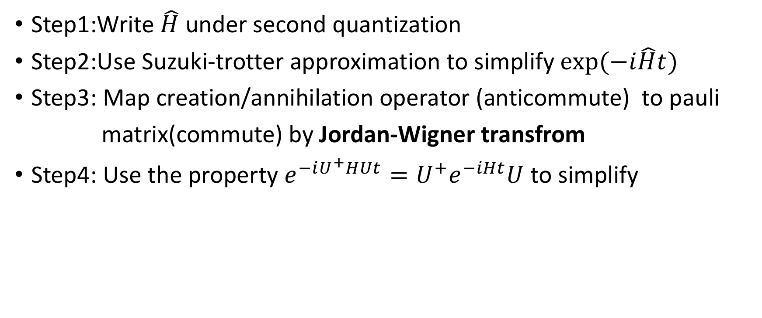
Hamiltonian Evolution:
Step1:Write $\hat{H}$ under second quantization
Step2:Use Suzuki-trotter approximation to simplify $exp⁡(−i\hat{H}t)$
Step3: Map creation/annihilation operator (anticommute) to pauli
matrix(commute) by Jordan-Wigner transfrom
Step4: Use the property ${{e^{−iU^{+}HUt}=U}^{+}e}^{−iHt}U$ to simplify

Slide 14
Data Extraction
Correlation Function
Hamiltonian spectrum

Slide 15
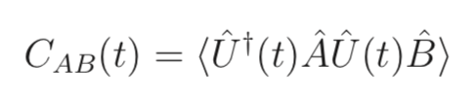
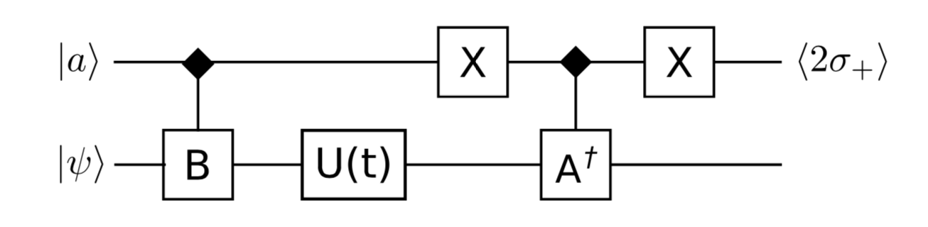
Correlation Function

Slide 16
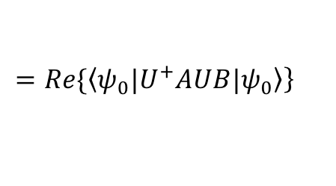
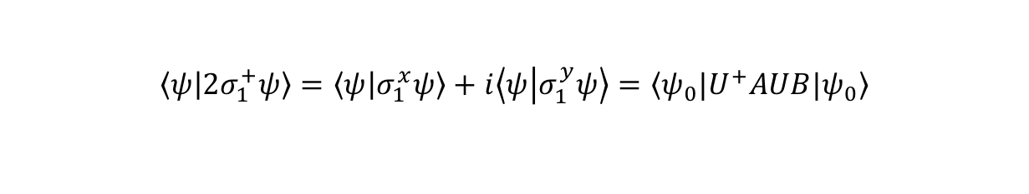
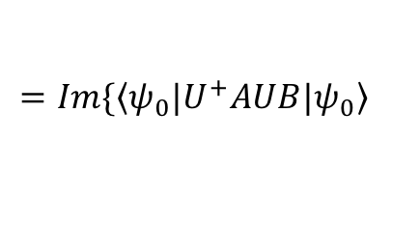
Expectation value
$$\left.=Re\{\left\langle ψ_{0}|\right.U^{+}AUB|\left.ψ_{0}\right\rangle \right\}$$
$$=Im\{\left\langle ψ_{0}|\right.U^{+}AUB|\left.ψ_{0}\right\rangle$$
$$\left\langle ψ | {2σ}_{1}^{+}ψ\right\rangle =\left\langle ψ | σ_{1}^{x}ψ\right\rangle +i\left\langle ψ | σ_{1}^{y}ψ\right\rangle =\left\langle ψ_{0}|\right.U^{+}AUB|\left.ψ_{0}\right\rangle$$

Slide 17
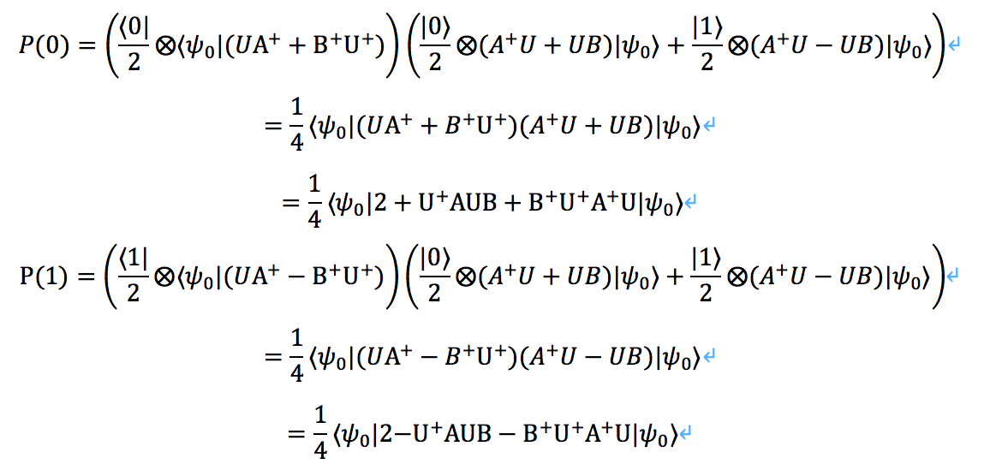
But how to derive expectation value from circuit?
For x:
Strategy: measure first qubit:
If 1: record 1
If 0: record -1
The expected value of the number
=P(0)*1+P(1)*(-1)
=

Slide 18
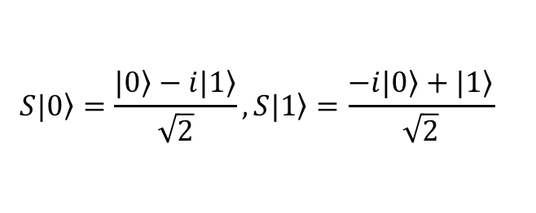
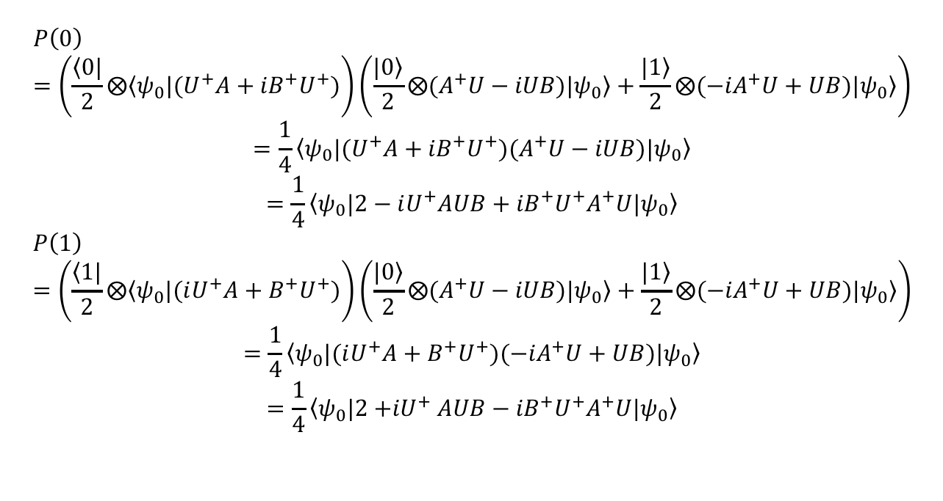

For y:
S=$\frac{1}{\sqrt{2}}\left[\begin{matrix}1 & −i \\ −i & 1\end{matrix}\right]$
$$S|\left.0\right\rangle =\frac{|\left.0\right\rangle −i|\left.1\right\rangle }{\sqrt{2}}, S|\left.1\right\rangle =\frac{−i|\left.0\right\rangle +|\left.1\right\rangle }{\sqrt{2}}$$
Strategy: measure first qubit:
If 1: record 1
If 0: record -1
The expected value of the number
=P(0)*1+P(1)*(-1)
=
$$P\left(0\right)=\left(\frac{\left\langle 0|\right.}{2}⨂\left\langle ψ_{0}|\right.{(U^{+}A+iB}^{+}U^{+})\right)\left(\frac{|\left.0\right\rangle }{2}⨂(A^{+}U−iUB)|\left.ψ_{0}\right\rangle +\frac{|\left.1\right\rangle }{2}⨂{(−iA}^{+}U+UB)|\left.ψ_{0}\right\rangle \right)$$
$$=\frac{1}{4}\left\langle ψ_{0}|\right.{(U^{+}A+iB}^{+}U^{+})(A^{+}U−iUB)|\left.ψ_{0}\right\rangle$$
$$=\frac{1}{4}{\left\langle ψ_{0}|\right.{2−iU^{+}AUB+iB}^{+}U^{+}A}^{+}U|\left.ψ_{0}\right\rangle$$
$$P\left(1\right)=\left(\frac{\left\langle 1|\right.}{2}⨂\left\langle ψ_{0}|\right.{(iU^{+}A+B}^{+}U^{+})\right)\left(\frac{|\left.0\right\rangle }{2}⨂(A^{+}U−iUB)|\left.ψ_{0}\right\rangle +\frac{|\left.1\right\rangle }{2}⨂{(−iA}^{+}U+UB)|\left.ψ_{0}\right\rangle \right)$$
$$=\frac{1}{4}\left\langle ψ_{0}|\right.{(iU^{+}A+B}^{+}U^{+}){(−iA}^{+}U+UB)|\left.ψ_{0}\right\rangle$$
$$=\frac{1}{4}{\left\langle ψ_{0}|\right.{2{+iU}^{+}AUB−iB}^{+}U^{+}A}^{+}U|\left.ψ_{0}\right\rangle$$

